Slide 1
HOME AUTOMATION USING NODE-MCU
.
FACULTY MEMBER DONE BY:
Dr. D.VAITHIYANATHAN GOUTHAM SRI CHARAN MEKALA 221220024

Slide 2
content
Introduction​
Literature review
​Objectives
Components used
Circuit design
Conclusion
references
​​

Slide 3
Introduction
Home automation systems using NodeMCU are a popular choice for creating smart homes. NodeMCU is an open-source development board based on the ESP8266 Wi-Fi module, which provides a platform for building Internet of Things (IoT) projects. With NodeMCU, you can connect various sensors, actuators, and devices to create a centralized control system for your home.
The basic idea behind a home automation system is to enable remote monitoring and control of various electrical and electronic devices within your home. By integrating these devices with NodeMCU, you can automate routine tasks, enhance security, and improve energy efficiency

Slide 4
Literature review
Home automation systems using NodeMCU have gained significant attention in recent years, offering the potential to create smart and interconnected homes
Hardware Integration: Several studies have focused on integrating various sensors and devices with NodeMCU, including temperature sensors, motion detectors, light sensors, and door/window sensors
Communication Protocols: The use of Wi-Fi connectivity and protocols like MQTT for communication between NodeMCU and other devices has been extensively researched.
Automation Logic and Rule-based Systems: Researchers have explored the implementation of rule-based systems and logic for automation in home environments.
Control Interfaces: The development of control interfaces, including mobile applications and voice-based assistants, has been a prominent research area.
Energy Efficiency and Sustainability: Several studies have focused on optimizing energy consumption in home automation systems.

Slide 5
Objective
Automation and Convenience: The primary objective is to automate routine tasks and provide convenience to homeowners.
Energy Efficiency: Another objective is to optimize energy consumption by implementing energy-saving techniques. By integrating energy monitoring sensors and smart control algorithms, the system can intelligently manage devices to reduce energy waste and promote sustainable practices.
Enhanced Security: The home automation system aims to enhance the security of the property and its occupants.
Integration and Interoperability: The system should have the capability to integrate with other smart devices and platforms, enabling interoperability. This objective allows users to control their home automation system through various interfaces, including mobile applications, voice assistants, and existing smart home ecosystems.
User Experience: An important objective is to provide a user-friendly and intuitive interface for homeowners to interact with the system

Slide 6
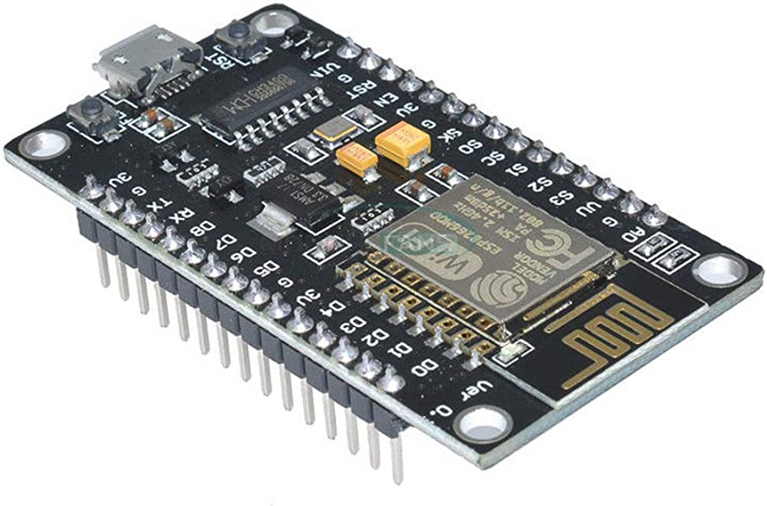
Components used
NODE MCU:
The ESP8266 chip incorporates on a standard circuit board. The board has a built-in USB port that is already fixed with wired up in the chip. The hardware reset button, Wi-Fi antenna, LED lights, and standard-sized GPIO (General Purpose Input Output) pins that can plug into a bread board. It has Processor called L106 32bit RISC microprocessor core based on the Ten silica Extensa Diamond Standard 106Micro running at 80 MHz and has a memory of 32 Kbit instruction RAM ,32 Kbit instruction cache RAM, 80 Kbit user data RAM&16 Kbytes system data RAM. It has inbuilt Wi-Fi modules of (IEEE 802.11 b/g/n) Wi-Fi technology. The ESP8266 is the name of a micro controller designed by Expressive Systems. The ESP8266 itself is one of the self-contained Wi-Fi networking solutions that also offering as a bridge from presented micro controller to Wi-Fi and is also capable of organization self-contained applications.

Slide 7
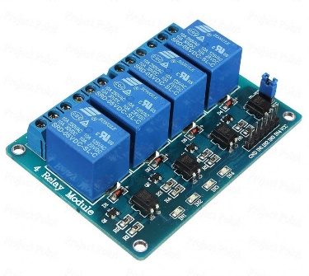
RELAY:
The Relay is nothing but it is the electromagnetic switching. Relay allows one circuit to switch another circuit while they are separated. Relay is used to low voltage circuit to turn ON and turn OFF the device which required high voltage for its operations. For example, 5V supply connected to the relay is sufficient to drive the bulb operated on 230V AC mains. Relays are available in various configurations of operating voltages like 6V, 9V, 12V, 24V. Normally the Relay is divided into two parts, one is input and other is output. Input side is nothing but a coil which is generate the magnetic field when small input voltage is given to it. Relay having three contactors: 1 set Normally closed (NC), 2 Nd normally opened (NO) and 3 rd. common (COM). By using the proper combinations of the contactors electrical appliances may turn ON or OFF.

Slide 8
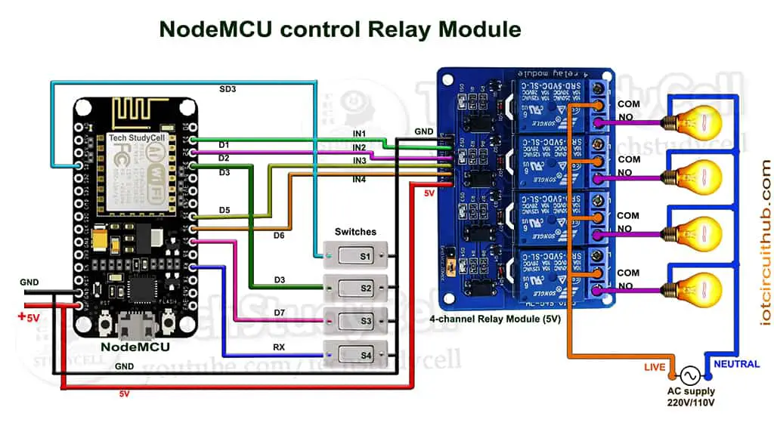
CIRCUIT DESIGN

Slide 9
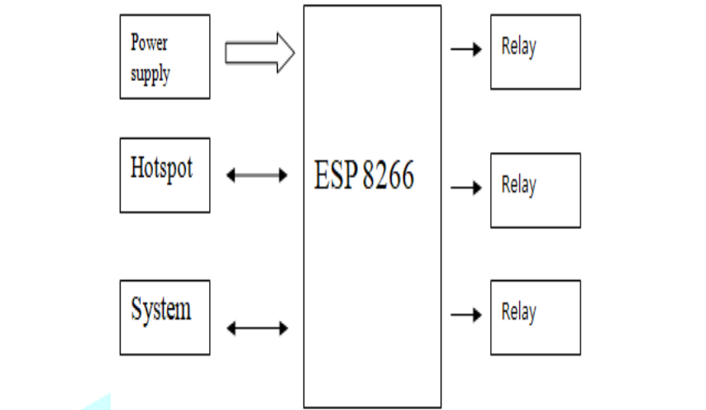
BLOCK DIAGRAM

Slide 10
conclusion
a home automation system using NodeMCU offers numerous benefits and possibilities for creating a smart and interconnected home. By leveraging the capabilities of NodeMCU and integrating various sensors, devices, and communication protocols, homeowners can automate routine tasks, enhance security, improve energy efficiency, and enjoy the convenience of remote monitoring and control
The system's ability to integrate with other smart devices and platforms provides interoperability and expands the possibilities for controlling the home automation system through different interfaces such as mobile applications and voice assistants.
The home automation system aims to provide a seamless user experience, with intuitive control interfaces that are easy to use and customizable according to individual preferences. The system promotes energy efficiency by implementing energy-saving techniques, and it enhances security through the integration of various sensors and automated actions.
Overall, a home automation system using NodeMCU holds the potential to transform a conventional home into a smart and efficient living space. With its capabilities for automation, energy optimization, security enhancement, and seamless integration, the system offers homeowners a more comfortable, convenient, and connected lifestyle.

Slide 11
REFERENCES
D. Norris, Smart Home Automation Based on IOT and Android Technology M. Abivandhana1, K. Divya2, D. Gayathri3, R. RuhinKouser4 Student1, 2, 3, Assistant Professor4 Department of CSE Kingston Engineering College, Katpadi, Vellore, India
International Journal of Innovative Studies in Sciences and Engineering Technology (IJISSET)IoT Based Home Automation Using Raspberry PI ISSN 2455-4863 (Online) www.ijisset.org Volume: 3 Issue: 4 | April 2017
S. Allam, M. M. R. Chowdhury, and J. Noll, “Sanaa’s: An event-driven sensor virtualization approach for internet of things cloud,” in Networked Embedded Systems for Enterprise Applications (NESEA), 2010 IEEE International Conference on, November 2010.
Z. Shelby, K. Hartke, and C. Bormann, (Aug. 28, 2013) Constrained application protocol (Coop), ‟‟ Core Working Group Internet-Draft. [Online].

Slide 12
THANK YOU

